Slide 1
Best City in lA county to open a fitness store

Slide 2
High demand for la county fitness stores
Los Angeles is home to Hollywood, one of the largest centers in the entertainment industry.
This attracts upcoming actors and actresses looking for a way to break into the industry.
Casting companies look for candidates that look healthy.
This results in many aspiring actors and actresses striving to maintain a healthy lifestyle.
The result is a high demand for gyms and fitness stores that carry products used to supplement training such as protein powder or pre workout.

Slide 3
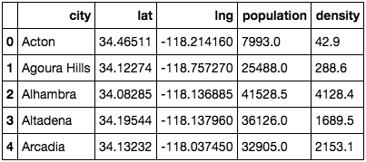
Data acquisition and cleaning
Data for all of the zip codes in the US from https://simplemaps.com/data/us-zips. This contains the longitude, latitude, county name, and city for every zip code in the United States.
Dropped all data that did not pertain to LA County.
Grouped the rows by city.

Slide 4
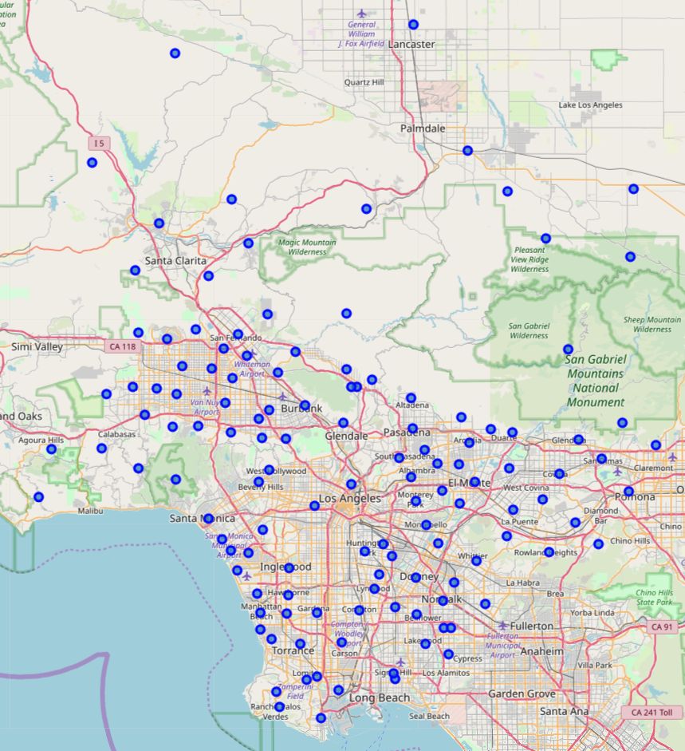
Map of all la cities using folium

Slide 5
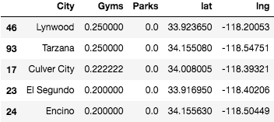
Foursquare venue data classification
Utilized Foursquare API to retrieve the venues in each city.
One hot encoded them according to venue category and grouped them by city.
Combined all gym related venues as the first attribute and all park related venues as the second attribute.
Indexed by city.

Slide 6
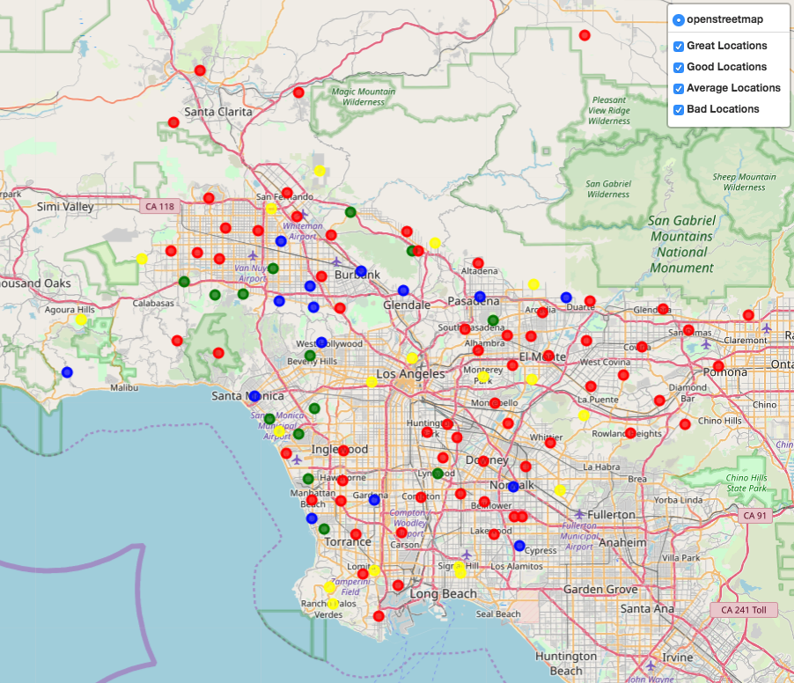
Map displaying all locations from great to bad
Green = Great
Blue = Good
Yellow = Average
Red = Bad

Slide 7
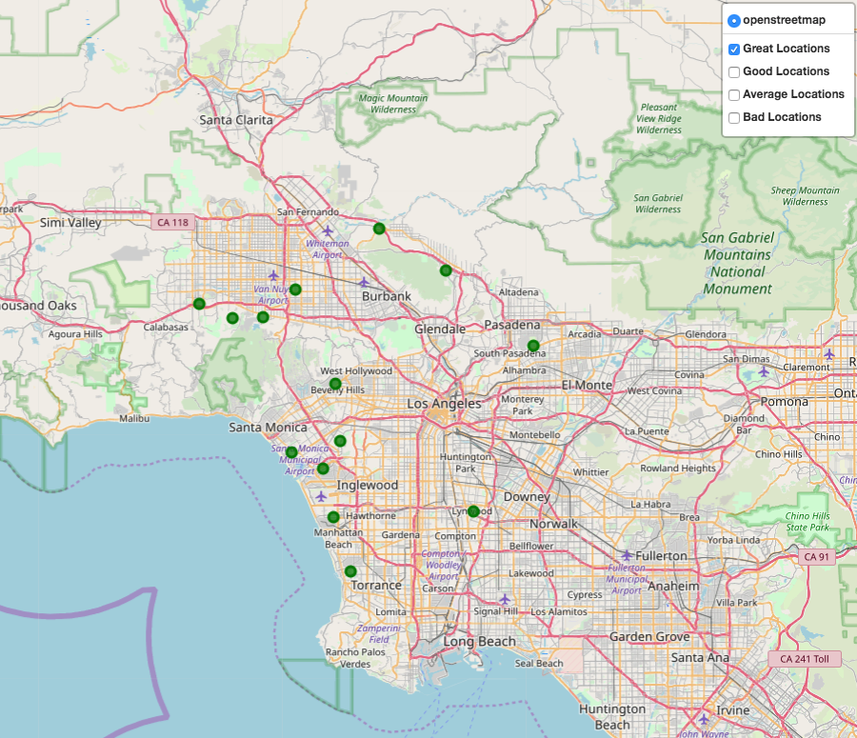
Recommended locations to open a fitness store
Venice
El Segundo
Redondo Beach
Playa Vista
Woodland Hills

Slide 8
conclusion
This study’s purpose was to locate the best cities in Los Angeles County to open up a fitness store based on the prevalence of gyms and parks.
With the employment of the Foursquare API, Folium maps, and classification techniques, I was able to produce an interactive map that shows not only the best locations to open up this fitness store, but also locations to avoid.

